Slide 1
Management of strabismus in trauma
Fusion 2012 LVPEI Hyderabad
Lionel Kowal
Melbourne

Slide 2
Trauma in strabismus
Damaged muscle after FESS
Direct trauma to rectus muscle
Flap tear
Blowout
2 seminal authors
Tony Murray
Irene Ludwig

Slide 3
JAAPOS 1998
JAAPOS June 1998

Slide 4
Murray Slipped & lost muscles
1. Slipped – within sheath
2. Inadvertently lost during an operation
3. Intraoperative snapping
PITS – Pulled In Two Syndrome
4. Late muscle detachment
5. Transection after facial or orbital trauma.
Assaults responsible for 80% of penetrating eye injuries @ Groote Schuur Hospital c.f. 22% of such injuries in US

Slide 5
Murray : 5. After facial or orbital trauma
29 pts, 32 muscles
IR > MR > LR > SR
Stab wounds [knife, bottle, fork] accounted for 26/32 muscles
Tip:
use a microscope & 2 assistants each with an eyepiece so that they can help you better

Slide 6
? Transected / avulsed muscle
Clues:
Duction & saccadic deficit are suspicious
Simple reliable tip:
Abnormal OKN – if quick phases in direction of action of muscle are normal [with OKN you always have the other eye’s behaviour as ‘control’] it is not transected & will recover
Even the best radiology can be misleading & understate the damage
? Capsule fills with blood and it looks too much like muscle – expected gap between the cut ends is not seen
If there is bedside evidence of transection you should explore even if the scan looks perfect

Slide 7

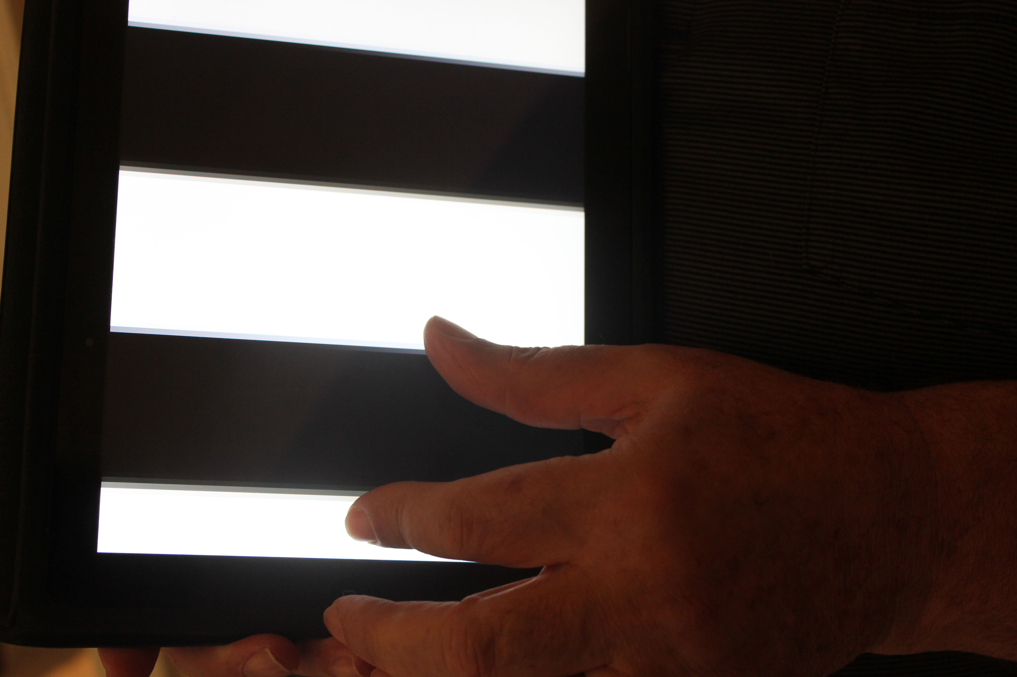
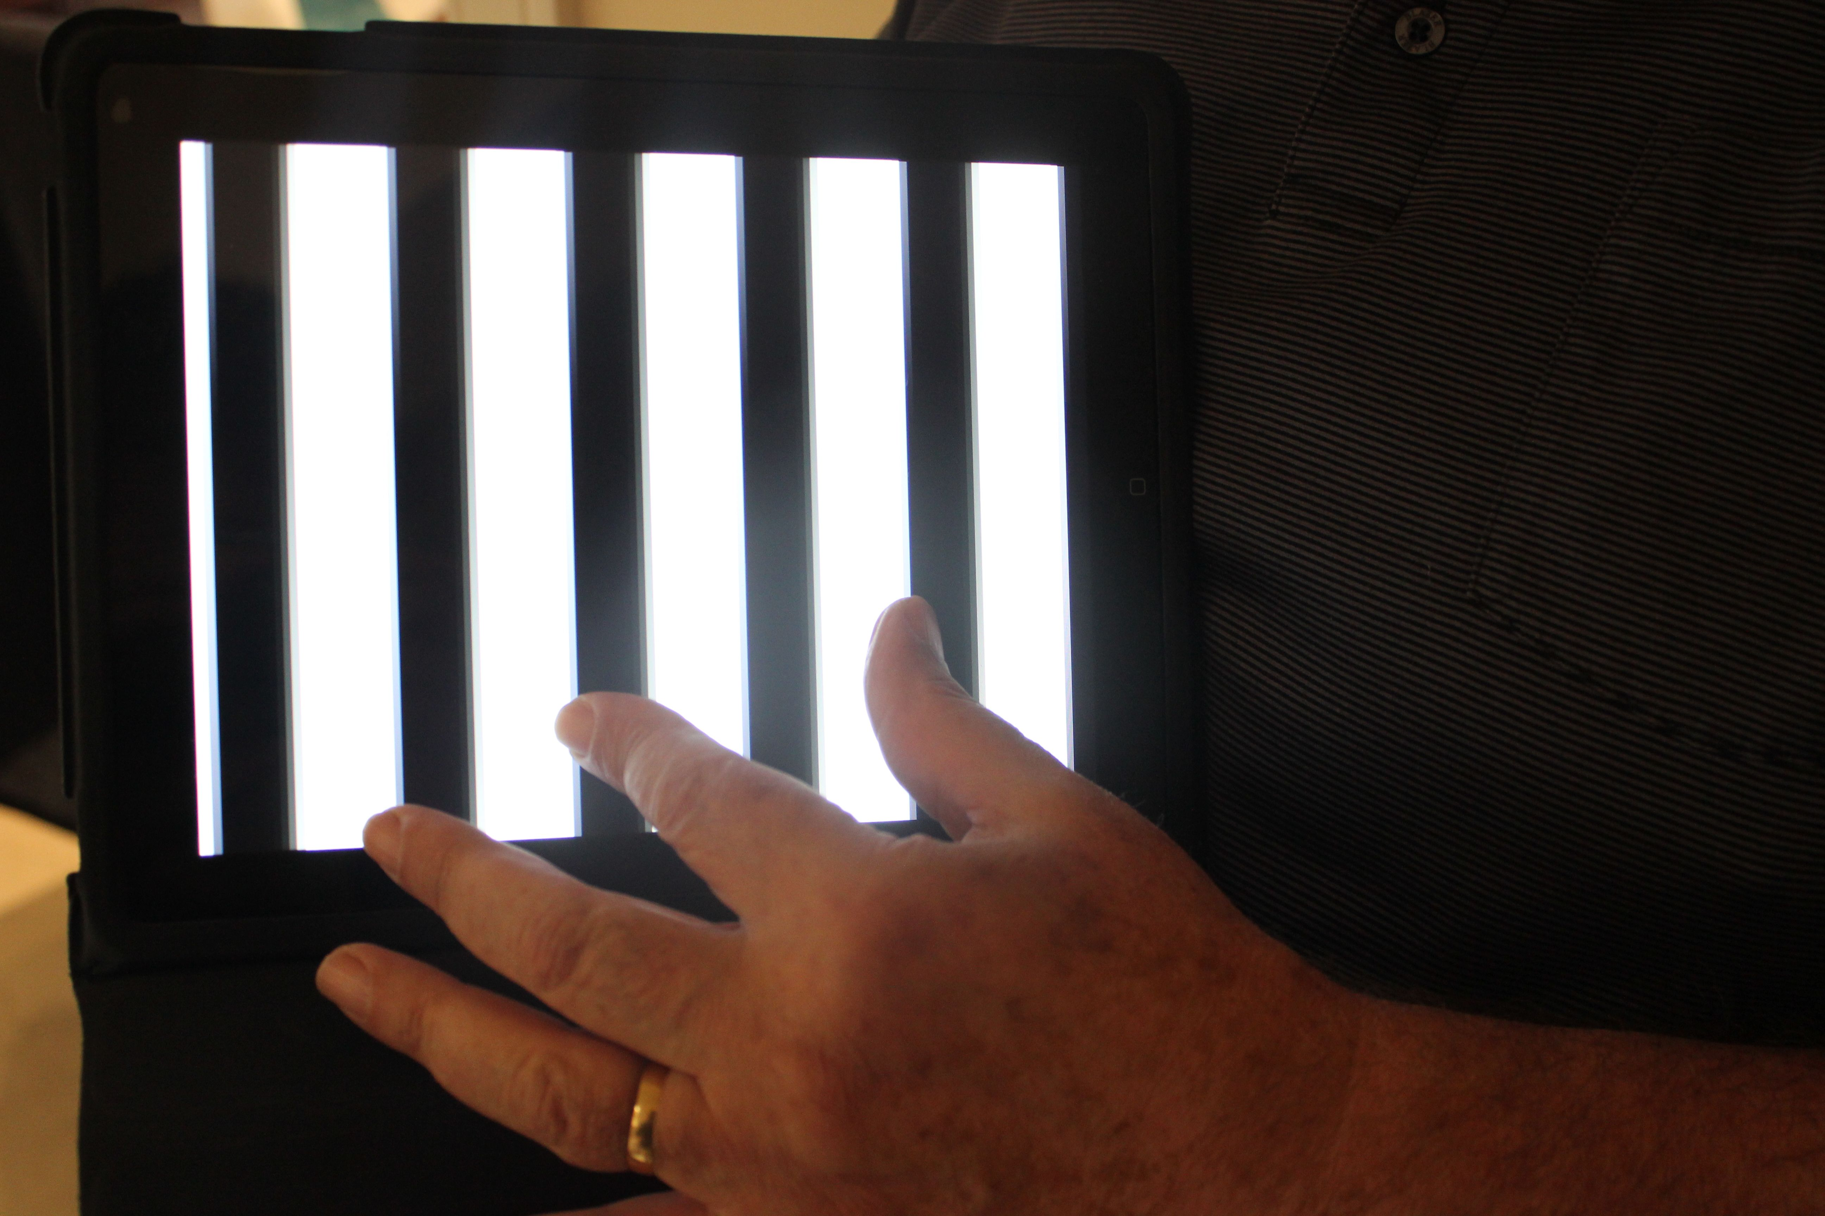
OptoDrum
Qualitative OKN for IPad
Test to see if LIR working: have stripes moving up. If quick movement ⬇ is symmetric OU, then LIR is working = will recover .
$2 - great value

Slide 8
Tr Am Ophth Soc 2001;99:53-63
…. a previously unreported avulsion-type injury of the rectus muscle, usually the inferior rectus
…the detached flap of external (orbital) muscle was found embedded in surrounding orbital fat and connective tissue. Retrieval and repair were performed in each case.
.. the predominant motility defect in 25 muscles was limitation toward the field of action of the muscle, presumably as a result of a tether created by the torn flap. These tethers simulated muscle palsy.
17 muscles were restricted away from their field of action, simulating entrapment.
The direction taken by the flap during healing determined the resultant strabismus pattern.
All patients presenting with gaze limitation toward an orbital fracture had flap tears. ….

Slide 9
Flap tear
The outer ½ of the terminal cm+ of the muscle [orbital layer] is partly disinserted & avulsed from the inner [global] layer, & the free end of that scars into the overlying orbital tissue
‘Forced duction testing was performed before and during muscle repair in all cases. Restrictions both toward and away from the direction of the involved muscle’s action were often present. In some cases the forced duction abnormality was subtle, and it only became evident when the procedure was performed gently, with simultaneous comparison to the uninjured contralateral eye’

Slide 10
Flap tear
‘I have postulated (thanks to the suggestion of David Stager, Sr), that at the time of injury, sudden downward traction by orbital septae on the outer, or orbital layer of the rectus muscle causes a partial avulsion of this layer away from the inner, global layer (as per Demer's anatomical work)....
John Avalone (Wash, DC) had a similar case, which he corrected by detaching the flap. but I usually try to reassemble all the pieces.

Slide 11
Orbital & global layers of the recti
MRI shows orbital and global layers of the recti
…& vertical recti can be seen on coronals [but not as well]

Slide 13
Flap tear
You can’t find what you don’t look for
‘Since the first case was identified in 1994 every patient presenting to this practice with a preoperative diagnosis of orbital fracture together with limitation of motility toward the direction of the fracture was found to have a flap tear’ Ludwig

Slide 14
Flap tear
You can’t find what you don’t look for
We have always attributed B/O# diplopia to direct fracture- associated muscle damage ± nerve damage as well
We now know there is a NEW additional mechanism for orbital- trauma –associated diplopia
How common is this in MY practice?...YOURS?...is it important to know/ recognise?

Slide 15
Flap tear
You can’t find what you don’t look for
How common is this? ..does this only happen in SE USA? ...is it important to know/ recognise?
Often the response to a downgaze deficit on the side of the # is contralateral IR Faden [or similar]….& this is more attractive than a difficult flap tear dissection and unfamiliar surgery
We need to prospectively re-write the strabismus of B/O# looking for flap tear in every pt coming to strabismus surgery
Work in progress

Slide 16
Diplopia after sinus surgery
79 y o lady
Post sinus surgery diplopia (worse in R Gaze, lately affecting primary), shuts one eye when reading.
Press-on prism – did not help.

Slide 17
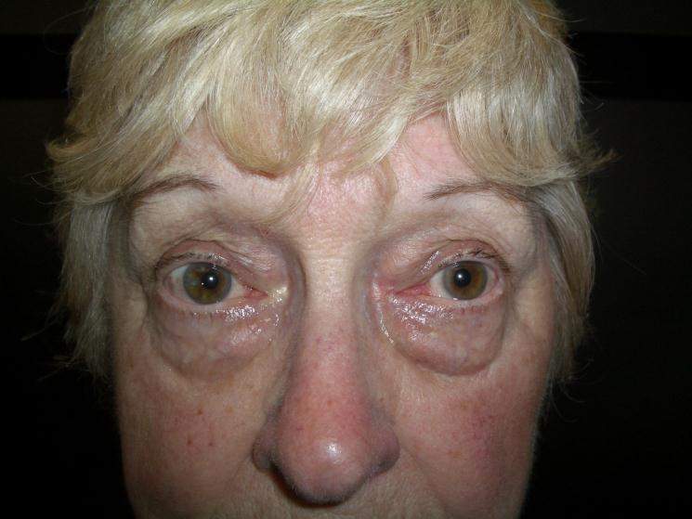
X(T) = 18 Δ, L gaze 4Δ, R gaze 30Δ
X’=25 Δ
LH 4Δ, greater on R gaze

Slide 18
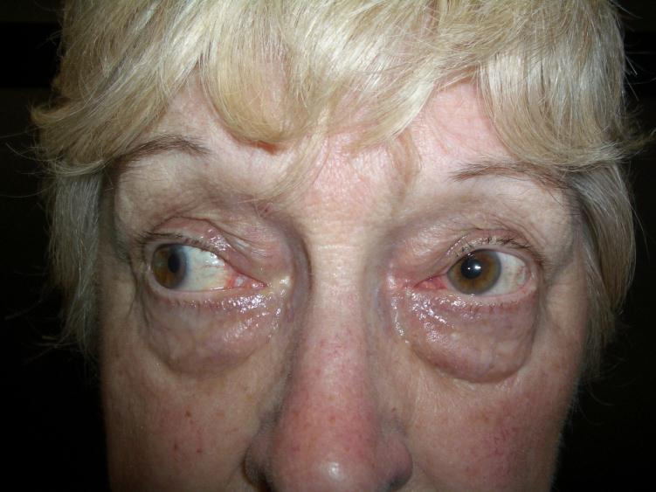
Right Gaze XT 30

Slide 19
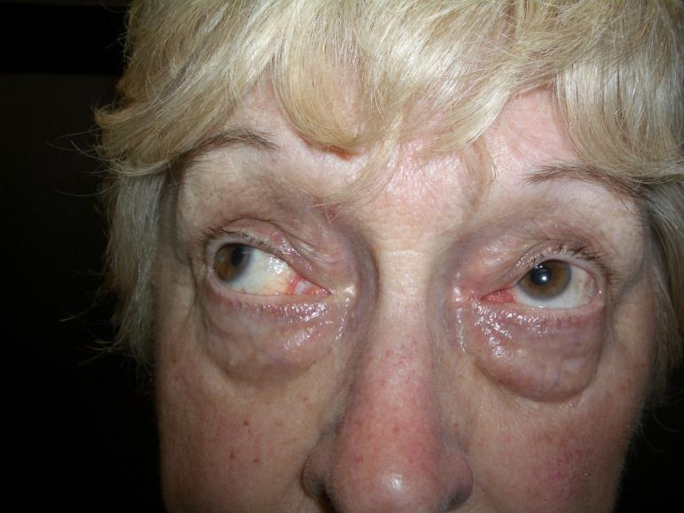
Up right

Slide 20
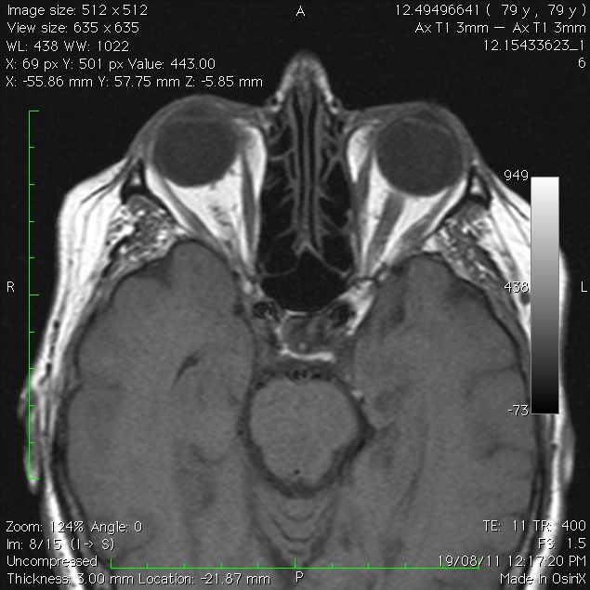
LMR tethered @ its midpoint to the lamina papyracea

Slide 21
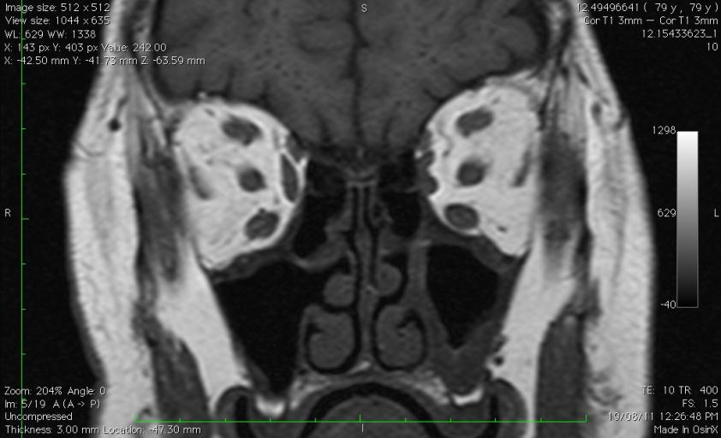
No intervening fat between LMR and orbital wall, nor between L SO and MR

Slide 22
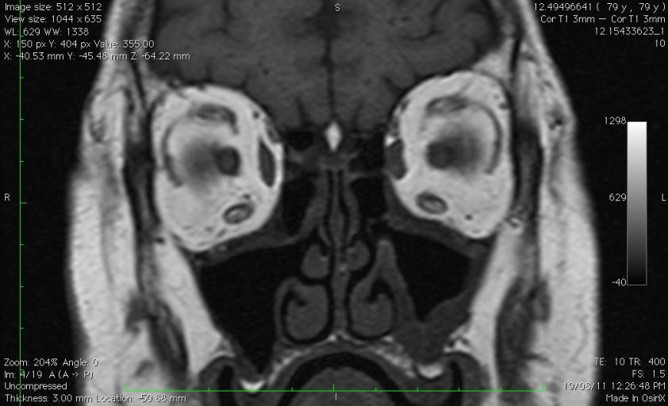
Abnormal morphology of LSO & LMR

Slide 23
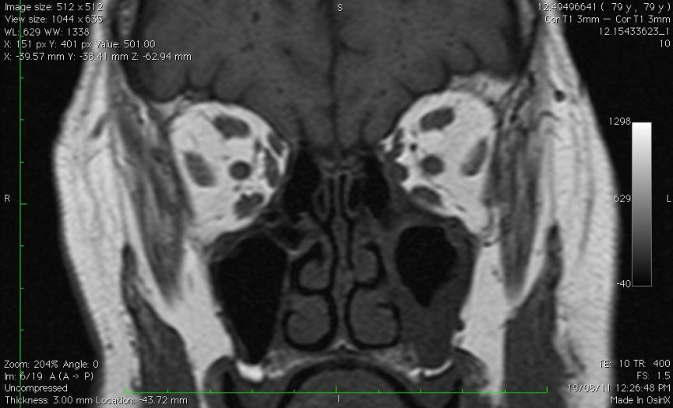
The MR tethered to the lamina papyracea.

Slide 24
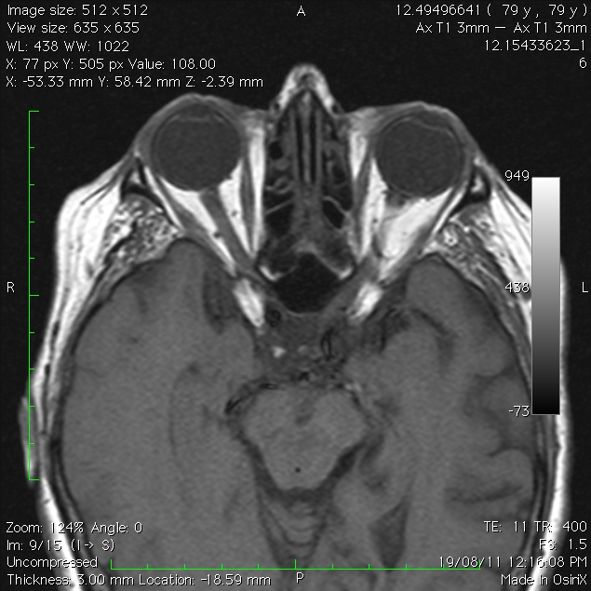

Slide 25
Plan 1
MR freed up and some orbital fat placed between muscle and repaired wall defect: no change

Slide 26
Plan 2
LIO weakening procedure.
LMR resection
To improve R gaze comitance, RLR Recess
If LLR tight → LLR recession.
Since this will make her ET in L gaze , she needs RMR recess as well

Slide 27
?Complete transection : be quick from Demer
Get multi-positional MRI/ CT early on. If the posterior muscle is contractile and re-anastamosis seems feasible, do the surgery early.
If muscle is in continuity but not contracting, wait for likely recovery [beware – review frequently lest the radiology be misleading]
If residual muscle is non-contractile or too much muscle has been lost already to consider repair, do a transposition early.

Slide 28
Unfortunately large literature 15 pts

Slide 29
Christine M. Huang, et al. Medial Rectus Muscle Injuries Associated With Functional Endoscopic Sinus Surgery (Ophthalmic Plastic and Reconstructive Surgery), 2002
30 cases from 1994-2000 from 10 centers.
16 men and 14 women.
Mean age: 45 y (range 20 - 76 y).
Follow-up from initial injury: 12m (2- 48m).
A spectrum of MR injury: simple contusion to complete MR transection, w and w/o entrapment.

Slide 30
Radiological series n=9
Commonest site of entry into orbit: lower medial orbital wall followed by inferior wall
MR injury > IR > SO
3/9: diffuse scarring – global motility disorder
Clin Radiol. Aug 2005
Orbital complications of functional endoscopic sinus surgery: MR and CT findings.
Bhatti MT, Schmalfuss IM, Mancuso AA.

Slide 31
Discussion(1)
The incidence of ocular complications during sinus Sx is low, but when they occur- have significant morbidity.
With increasing interest in endoscopic sinus surgery, more ocular complications are likely to occur.
MR, the most commonly injured extraocular muscle (direct laceration, neurovascular interruption, entrapment or adhesions to adjacent structures).
Post-op CT is important in assessing the medial wall, the MR and surrounding orbital soft tissues and the size and location of the medial wall bony defect.

Slide 32
Discussion (2)
  Treatment of the MR injury includes:
  Early exploration (within 2- 3/52), freeing or repair of entrapped tissues, and cover the bony defect with an implant if necessary.
  Reattachment of the lacerated ends of the MR improves PP alignment.
  Adjunctive weakening of the antagonist LR with BTX injection (5 units under direct visualization).
  Vertical transposition if MR transected, to improve aDduction.

Slide 33
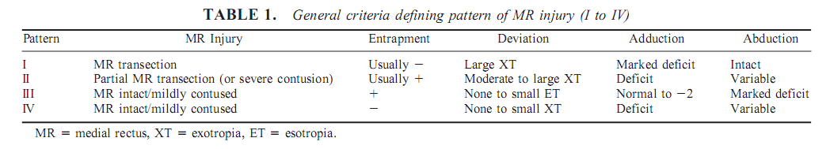
Four general patterns of presentation and corresponding injuries were categorized:
Our pt is pattern II
Tx in I and II (MR tissue loss) is challenging.
Observation / IV steroids alone → did not result in improved ocular alignment.
Early exploration of the entrapped muscle with suturing the muscle remnants, BTX injection to the ipsilateral antagonist (LR), improved primary ocular alignment.
Late orbital exploration→ had limited results.
Vertical rectus muscle transposition as a secondary late procedure→ variable improvement on ocular motility.

Slide 34
Diplopia after frontal sinus surgery 2
Brown’s:
Very tough cases
One surgical attempt: no effect
Sup Obl tenotomy did not improve the intraop FDT
Sup obl palsy – no Brown’s
Behaves like ‘regular’ SOP

Slide 35
Blowout #s - children
In children, many are trapdoor and may have few/no radiological signs cf adults - ‘White eyed blowout’
Nausea/ vomiting more common in kids - disturbed oculocardiac reflex
Earlier surgery better
Pediatric orbital ﬂoor fractures
Leslie A. Wei, MD, and Vikram D. Durairaj, MD
JAAPOS 2011

Slide 36
Thank you

